Slide 1
Chat with any website
Albert Bausili, Bernat Borràs, Noa Yu Ventura

Slide 2
TECH STACK
API: fastapi
VDB: chromaDB
DB: chromaDB
EMBEDDING: MiniLLMv6
GENAI MODEL: Any OpenAI model (For this tests we used GPT4o-mini)
SCRAPPING: Beautiful Soup 4
PDF PROCESSING: PDFium2, tesseract
FRONTEND: HTML + Vanilla JS + CSS
DOCKERIZED

Slide 3
We are not from software, so no diagram
Spaghetti code, it’s a hackathon

Slide 4
OUR Biggest flex: Only One Prompt
Gemini 2.5 Pro

Slide 5
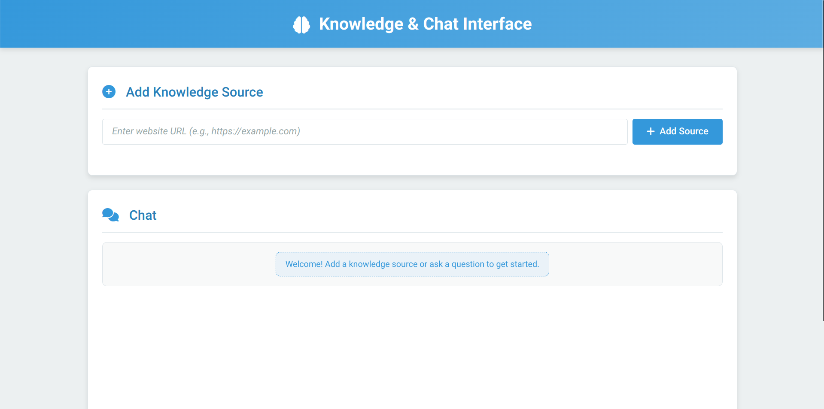

Slide 6
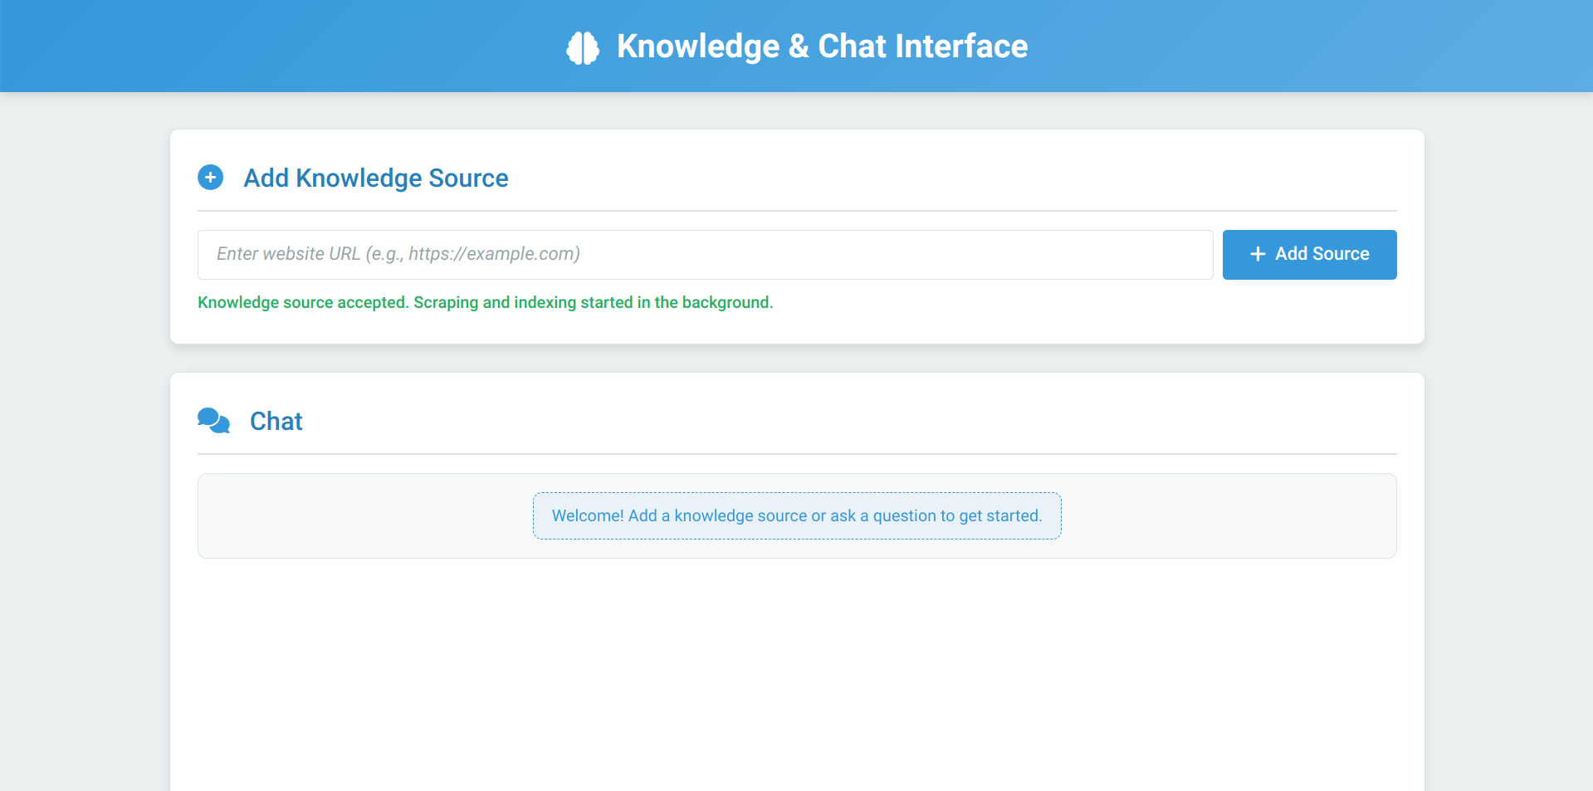

Slide 7
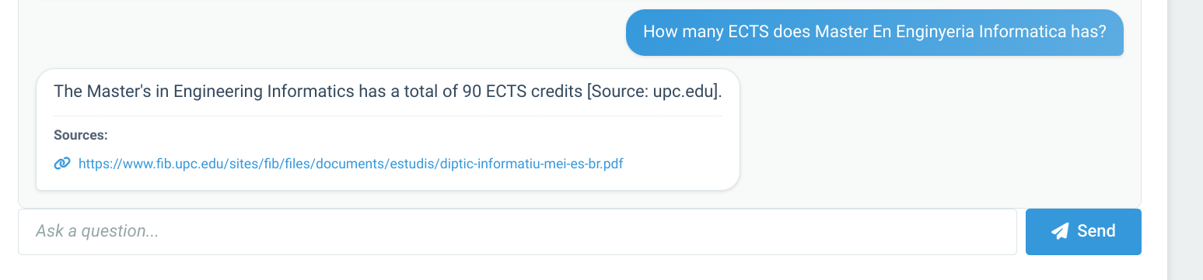

Slide 8


Slide 9
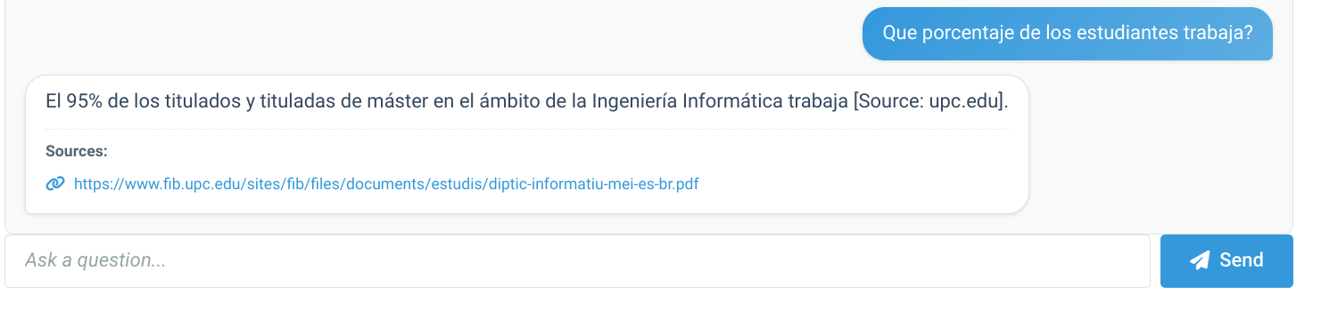

Slide 10
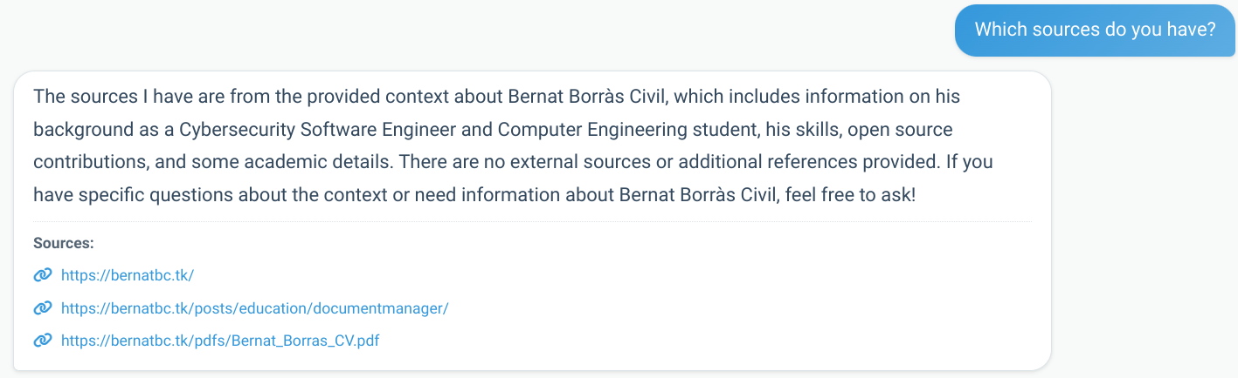

Slide 11
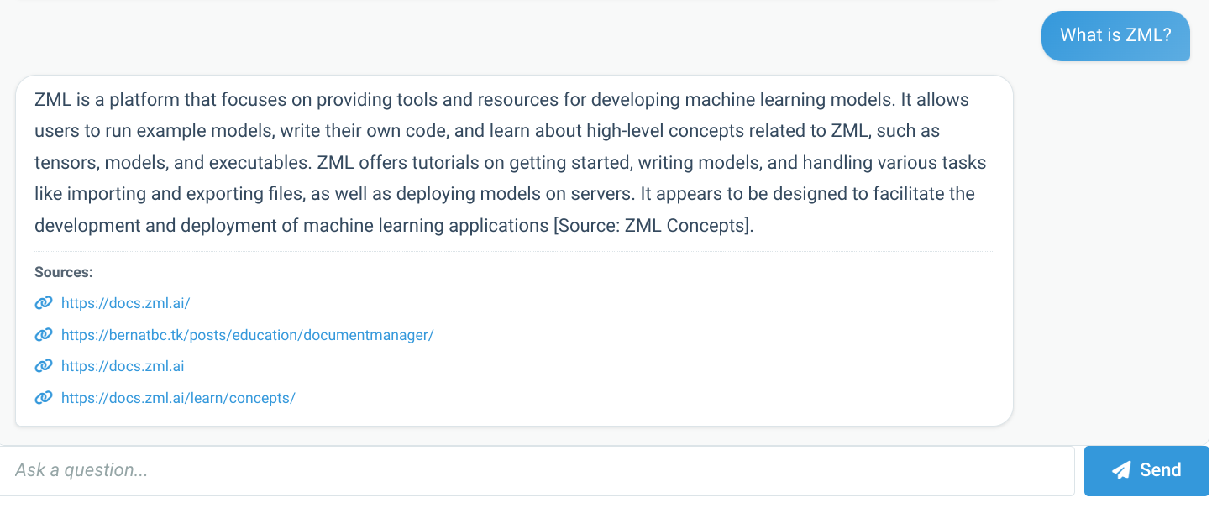

Slide 12
